Slide 1
BOEKEL ECO VILLAGE
Phat Thien Phuc Mark / Nguyen
Akshara Shukla
Juan Jacques Ludick
Yanislava Stefanova
Dylan Zeiss
Mel Ouwens
Group 5

Slide 2
Table of Contents
Project Recap
Research Question
Sprint 2 Results
Web Application Prototype
Sprint 3 Implementations
Feedback

Slide 3
Project Timeline
Week 01
Week 9
Week 17
Week 05
Week 13
Complete EDA
Web App Login
Initial Working of Research AI.
Working Database Design
API Integrate & Deployment
Finalize Web Application
Connected Database
Product testing
Start Research
Database Build
Initial Version of C# Application
Finalize Web App 70%
Dashboard
Modeling And Prediction
Cyber Security Apply
Final Presentation and Feedback

Slide 4
Project Recap
Sensor Air-Quality-Index Analysis.
Web Application Manager Protype. + Cyper Security Applied.
Artificial Inteligent Applied and Deployment.

Slide 5
RESEARCH QUESTION
How can we personalize EcohomeAI technology with AI and Software in augmenting the air quality index at Ecovillage Boekel?

Slide 6
Sprint 2 Results

Slide 7
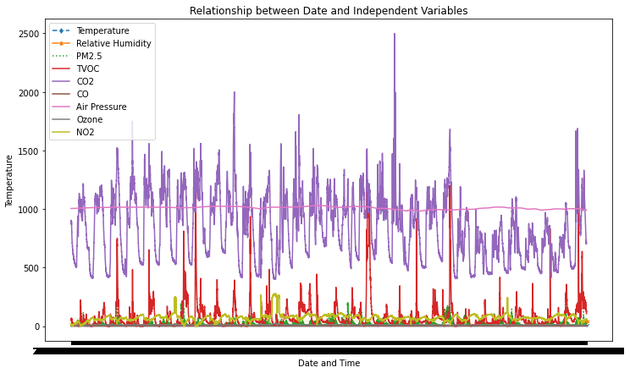
Quantitative Research

Slide 8
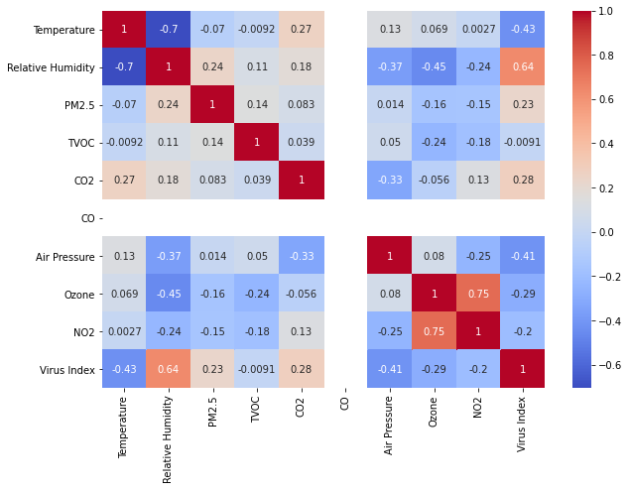
Quantitative Research

Slide 9
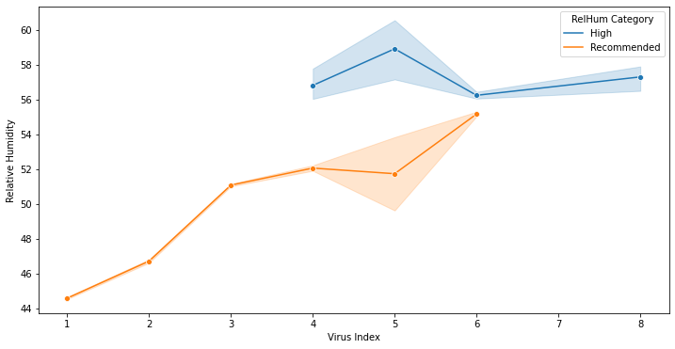
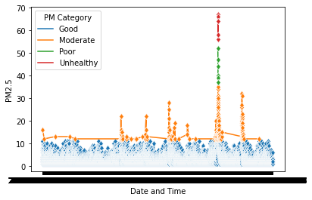
Key Air Parameters

Slide 10
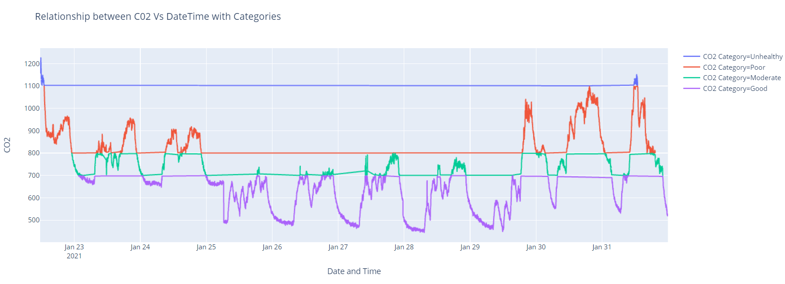
Key Parameters

Slide 11
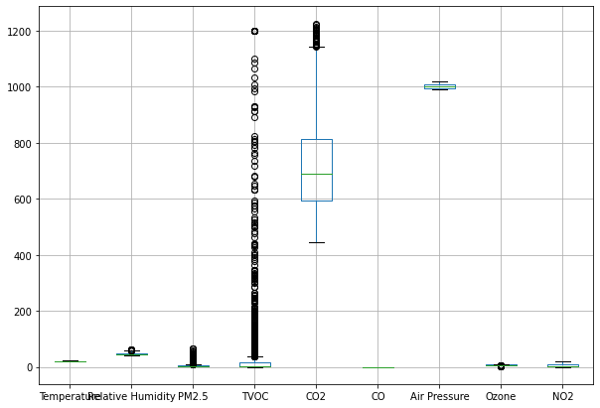
Dealing with Outliers

Slide 12
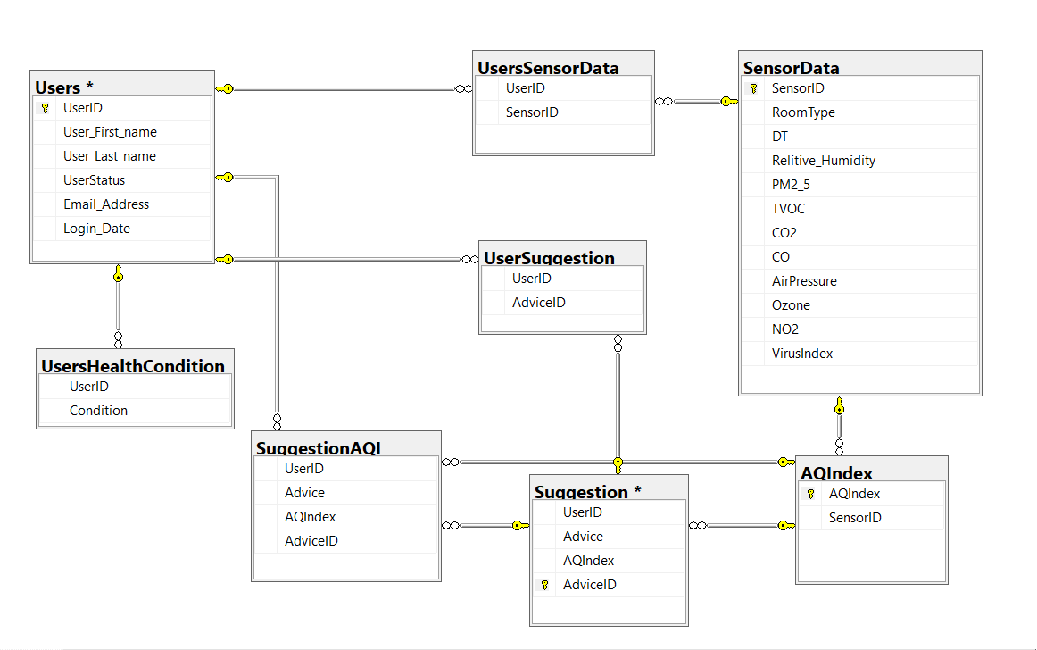
Database

Slide 13
EcohomeAI 1.0

Slide 14
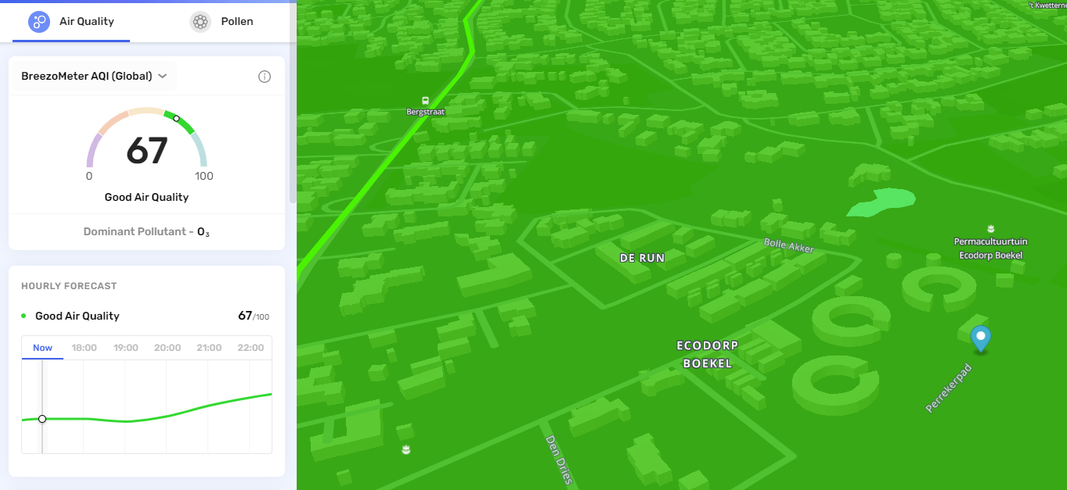

EcoDorp AQI From Outside

Slide 15
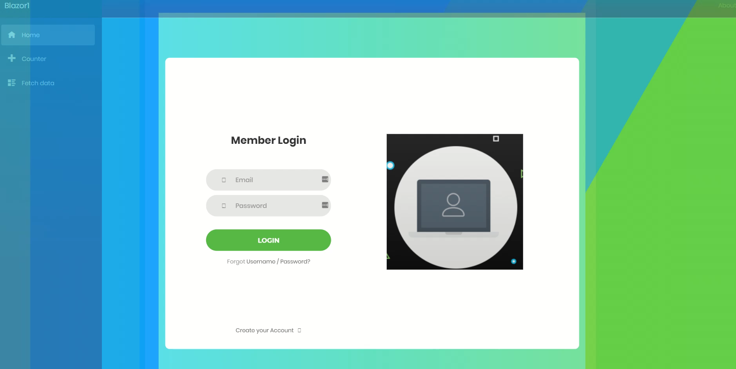
Web Application Version 1.0

Slide 16

Cyber Security Risk Analysis
Firewalls
Require stronger passwords
Encrypt the password hashes
Encode potentially harmful characters
Account locked after few failed login attempts

Slide 17
Sprint 3 Implementations

Slide 18
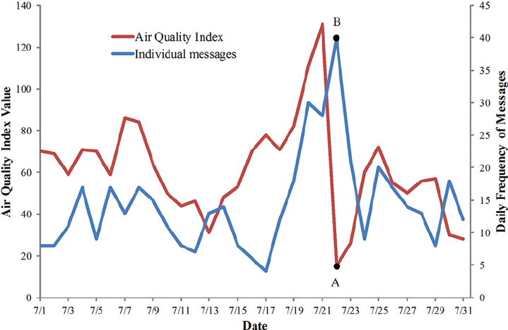
AQI Warning and Advices

Slide 19
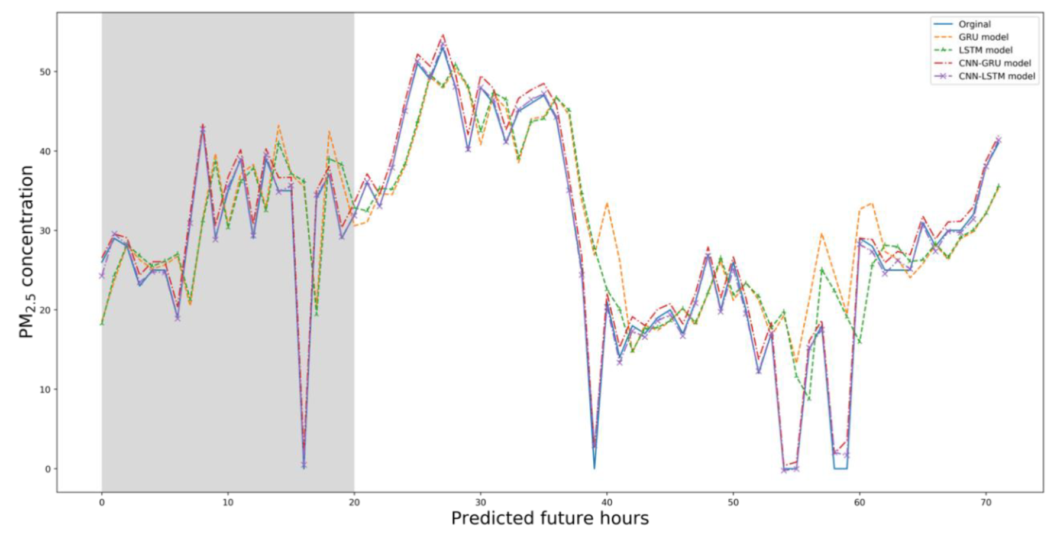
Technique for Index Prediction

Slide 20
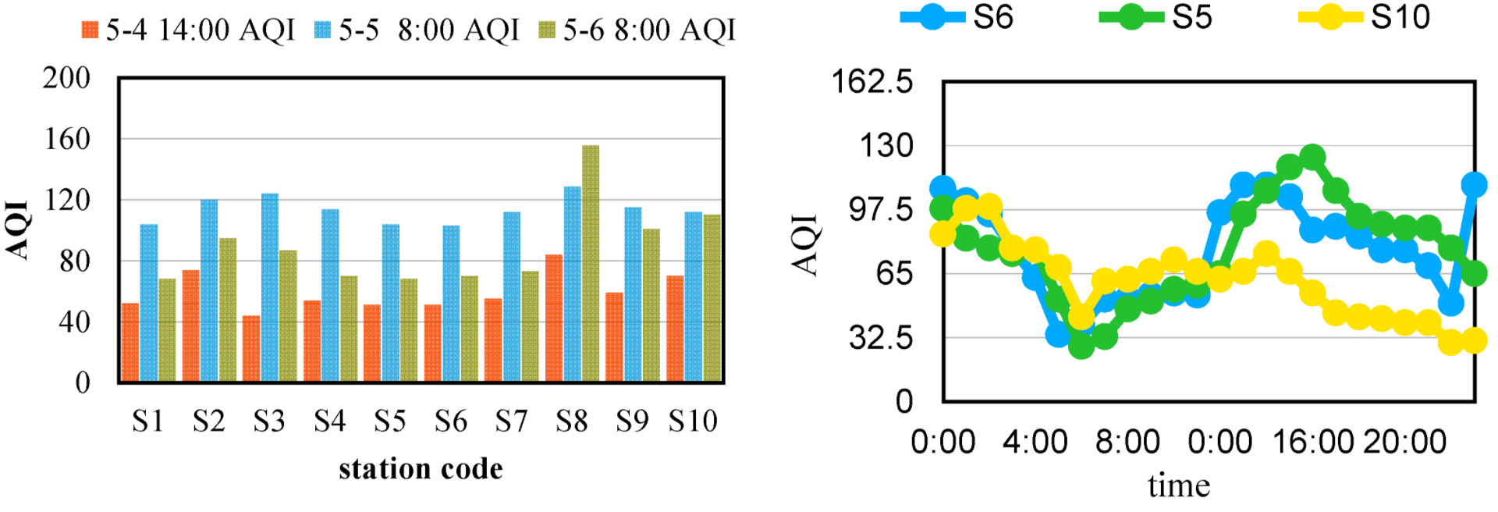
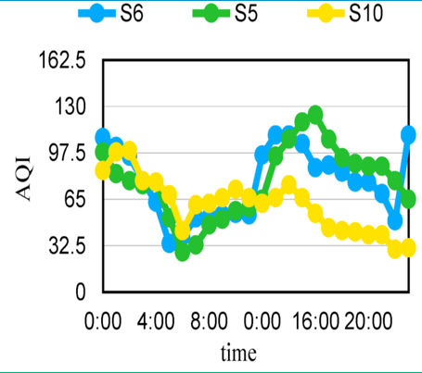
Applying Stations for Hourly Prediction

Slide 21
Sprint 3 Implementations
Implementing Security Model
Populating Database
Web Application v1.1
Integrating sensor data with web application

Slide 22
Thank You!

Slide 23
Feedback?

Slide 24
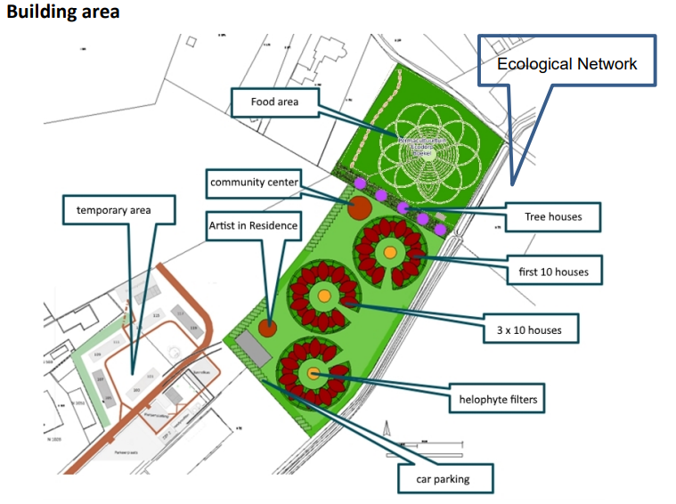
Spatial Description
Mapping the area of EcoDorp
3 blogs house system of sensors
population by year 2020
With >30.000 Rows of Data in Sensor
Collect focus on the Building Block House.
Living Room + Bedroom
Air Effective and Virus Index from outside.

